Slide 1
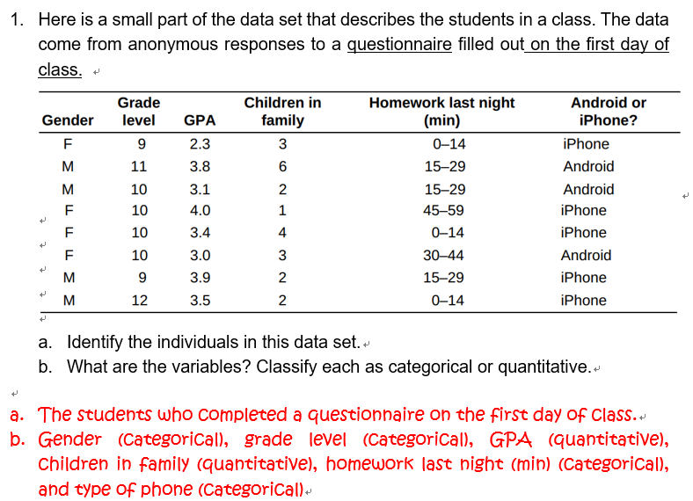


Slide 2

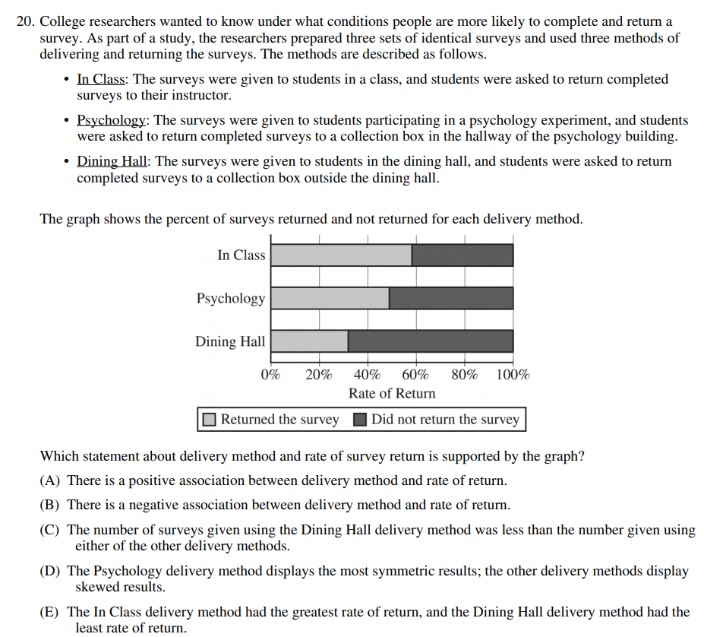

Slide 3
Lecture 3 Graphical Methods for Describing Data
Displaying Categorical Data
by Graph
Ref: Introduction to Statistics and Data Analysis
The Practice of Statistics

Slide 4
Learning Objects:
Display categorical data with a bar graph
Display categorical data with a pie chart
Describe the association between two categorical variables by segmented bar graph, side-by-side bar graph and mosaic plot

Slide 5
How to display categorical variables?
Frequency tables can be difficult to read.
Sometimes it is easier to analyze a distribution by displaying it with a bar graph or pie chart.

Slide 6
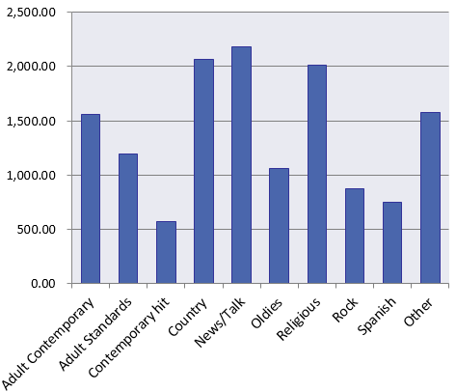
Bar Graph
Bar graphs compare several quantities by comparing the heights of bars that represent those quantities. Our eyes, however, react to the area of the bars as well as to their height.
When you draw a bar graph, make the bars equally wide.
Frequency Table
Format | Count of Stations
Adult Contemporary | 1556
Adult Standards | 1196
Contemporary Hit | 569
Country | 2066
News/Talk | 2179
Oldies | 1060
Religious | 2014
Rock | 869
Spanish Language | 750
Other Formats | 1579
Total | 13838

Slide 7
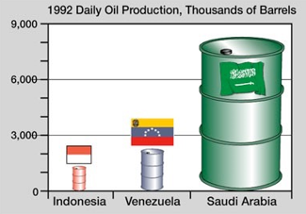
！！！！！AVOID ！！！！！

Slide 8
Pie Chart
Relative Frequency Table
Format | Percent of Stations
Adult Contemporary | 11.2
Adult Standards | 8.6
Contemporary Hit | 4.1
Country | 14.9
News/Talk | 15.7
Oldies | 7.7
Religious | 14.6
Rock | 6.3
Spanish Language | 5.4
Other Formats | 11.4
Total | 99.9

Slide 9
Note that a pie chart must include all categories that make up a whole, which might mean adding an “other” category, as in the left sample.

Slide 10
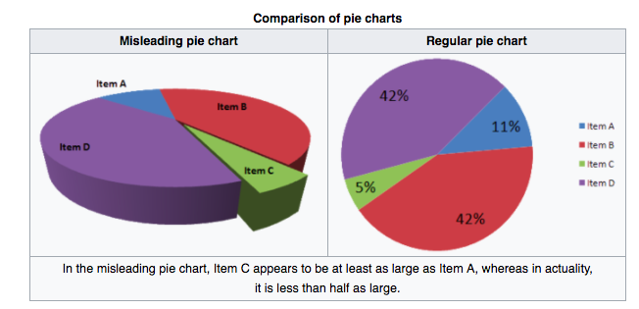
！！！！！AVOID ！！！！！

Slide 11
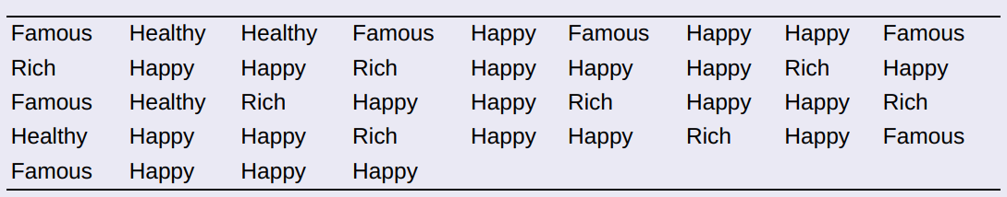
Check your understanding
The American Statistical Association sponsors a web-based project that collects data about primary and secondary school students using surveys. We used the site’s “Random Sampler” to choose 40 U.S. high school students who completed the survey in a recent year. One of the questions asked: Which would you prefer to be? Select one. ________Rich ________Happy ________Famous ________Healthy Here are the responses from the 40 randomly selected students:
Make a relative frequency bar graph of the data.

Slide 12
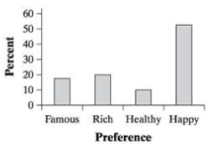
A slight majority (52.5%) of students in the sample said they would prefer to be Happy.
Rich and Famous were preferred about equally (20% and 17.5%).
The least popular choice was Healthy (10%).

Slide 13
Analyzing Data on
Two Categorical Variables

Slide 14
Response | Male
Almost no chance | 4.0%
Some chance | 11.6%
A 50-50 chance | 29.3%
A good chance | 30.8%
Almost certain | 24.3%
Female
4.1%
18.0%
29.4%
28.0%
20.5%
How to examine or compare conditional distributions:
Select the row(s) or column(s) of interest.
Use the data in the table to calculate the conditional distribution (in percents) of the row(s) or column(s).
Make a graph to display the conditional distribution. Use a side-by-side bar graph or segmented bar graph to compare distributions.

Slide 15
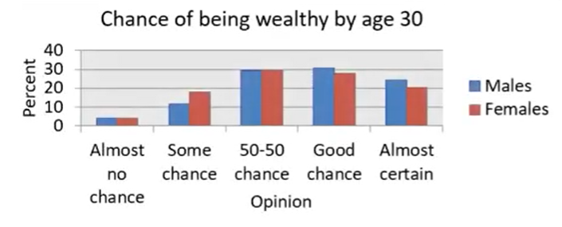
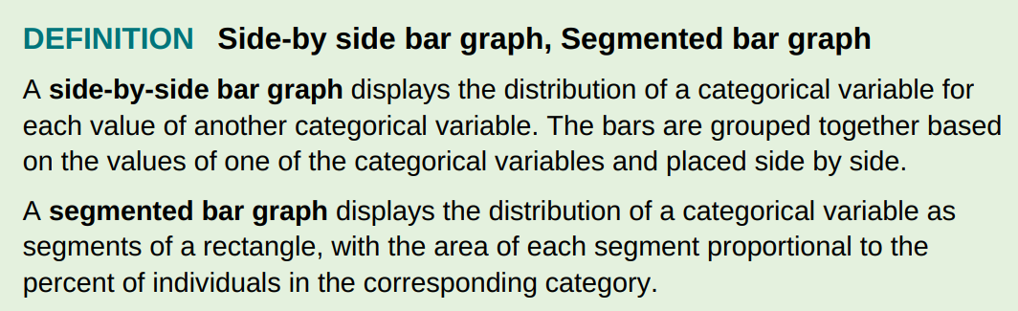

Slide 16
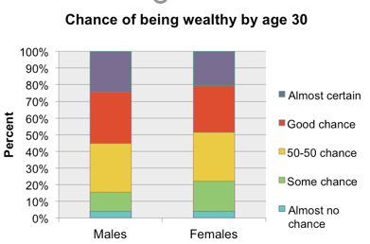
Relationships Between Categorical Variables

Slide 17
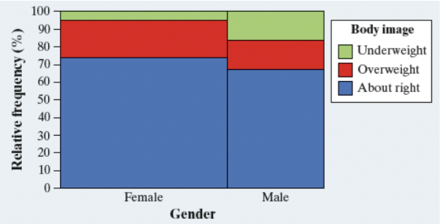
MOSAIC PLOTS
A mosaic plot is a modified segmented bar graph in which the width of each rectangle is proportional to the number of individuals in the corresponding category.

Slide 18


